Slide 1
Sigma HBASE Tables
F10 Data Science
Liu Shuang

Slide 2
Sigma Lot
Row key
Lot ID with the first 6 digits reversed [e.g.: 0000081.001 (The original lot Id should be 8000001.001)]
Purpose is to balance HBASE Regions
Column Family
cf
Column Qualifier
There are two categories of Column qualifier
Run_Complete_Datetime:::LS:Step_ID::Attribute
Run_Complete_Datetime:::LS:Step_ID::test_dwid::item_sequence_no
Timestamp & Value
1
2

Slide 3
Sigma Lot
1
2
1.
2.
lot_ID | Run_complete_datetime | Step_no | Attribute | timestamp | value
Lookup in HBase lookup table
lot_ID | Run_complete_datetime | Step_no | Test_dwid | Item sequence no. | timestamp | value
Lookup in HBase lookup table
Lookup in sigma_test_def table

Slide 4
Sigma Wafer
Row key
Lot ID first 7 digits (first 6 digits reversed)_wafer ID (e.g.: 0000081_0001-01)
Column Family
cf
Column Qualifier
There are two categories of Column qualifier
Run_Complete_Datetime:::LS:Step_ID::Attribute
Run_Complete_Datetime:::LS:Step_ID::test_dwid::item_sequence_no
Timestamp & Value
1
2

Slide 5
Sigma Wafer
1
2
1.
2.
lot_ID + wafer ID | Run_complete_datetime | Step_no | Attribute | timestamp | value
Lookup in HBase lookup table
lot_ID + wafer ID | Run_complete_datetime | Step_no | Test_dwid | Item sequence no. | timestamp | value
Lookup in HBase lookup table
Lookup in sigma_test_def table

Slide 6

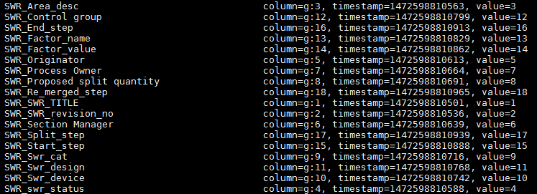
Lookup Table
Reference table for
Process Step (Daily Update) (We only use this in Sigma Data)
Material Batch Attributes (One Time)
SWR/QDR Attributes (One Time)
CT/QT Attributes (One Time)
To optimize the cost of column qualifier storage
Delimiter:
LS - Step
LG - General

